Slide 1

Admission Portal
Software Engineering

Slide 2




Meet our team
Saba Faryal
Ghania Naveed
Samia Azhar
Umber Gull

Slide 3
Agenda
Introduction
Requirements
UseCase
Activity Diagram
Test case
Presentation Title

Slide 4

Introduction
This project outlines the requirements for an Online Admission Portal for a university. The system will be used by student to manage the admission process for new students

Slide 5
Requirements
Functional Requirements
Register Students
View Grades
Display Enrolled students
Search for Students
Check Eligible/Ineligible Students
Reporting
Non Functional Requirements
The system shall be user-friendly and easy to navigate.
The system shall be secure and protect the privacy of student data.
The system shall be available 24/7.
The system shall be able to handle a large number of concurrent users.

Slide 6





Plan for our system
Planning
Requirements
coding
Testing
Output

Slide 7
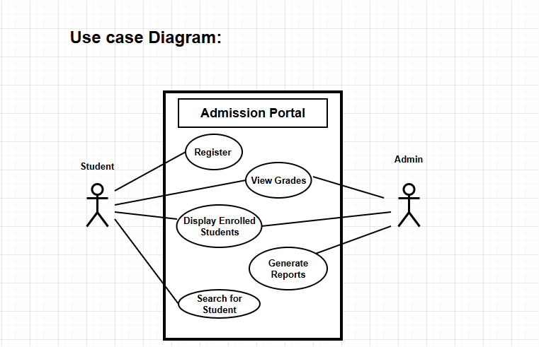
AI techniques, particularly machine learning and deep learning, are employed to build predictive models that forecast weather conditions with improved accuracy. These models learn from historical weather data, including atmospheric pressure, temperature, humidity, and wind patterns, to predict future weather patterns
Use Case

Slide 8
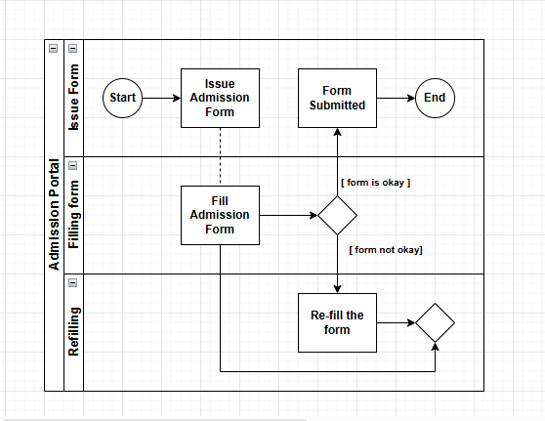


Activity Diagram
Real-Time Data Processing.
API algorithms process real-time data from weather sensors, radars, and stations.
Providing up-to-date information on weather conditions.
By analyzing this data in real-time.
API helps generate timely forecasts, allowing for rapid response and decision-making in various industries.

Slide 9
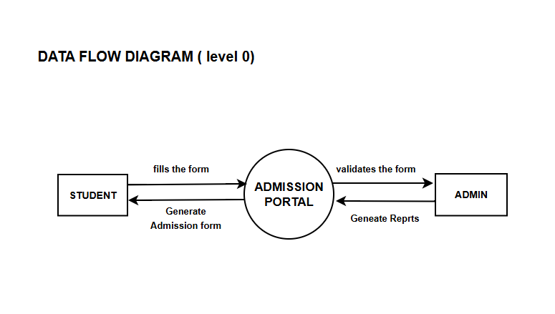
DFD(data flow diagram)

Slide 10
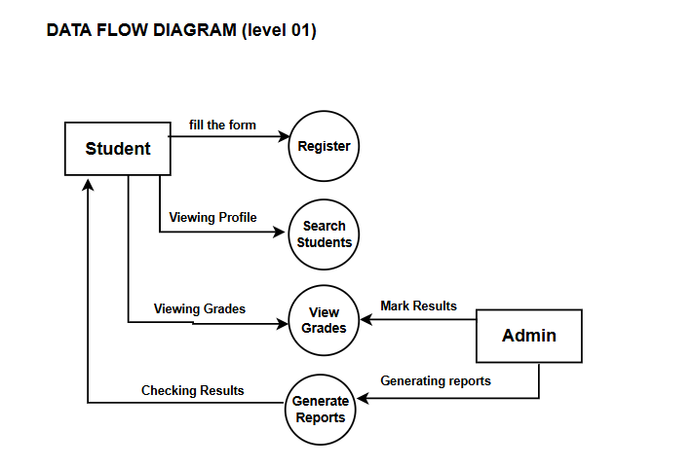
DFD(data flow diagram)

Slide 11
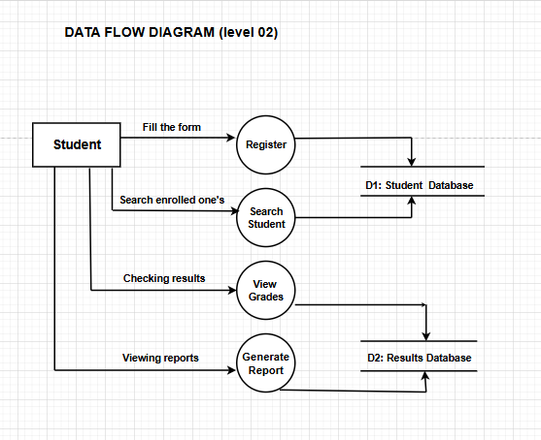
DFD(data flow diagram)

Slide 12

Test case Scenario Test case:1 Register Student:
Field Details
Test Case ID
Test Scenario
Test Steps
Prerequisite
Test Data
Expected Result
Actual Result
Environment
Comments
TC_001
Verify if a student can successfully register on the portal.
1. Open the Admission Portal.2. Click on "Register".3. Enter required details (name, email, password, etc.).4. Submit the form.
Student must not already be registered.
Name: John Doe, Email: john@example.com, Password: Password123.
Student registration is successful, and a confirmation message is displayed.
[To be filled after execution].
Web Browser: Chrome 112, OS: Windows 10.
Ensure email validation is applied.

Slide 13
Test case :2 Veiw Grades:
Field Details
Test Case ID
Test Scenario
Test Steps
Prerequisite
Test Data
Expected Result
Actual Result
Environment
Comments
TC_002
Verify if a student can view their grades.
. Login to the Admission Portal.2. Navigate to the "View Grades" section.3. Verify grades are displayed.
Student must be enrolled and grades must be uploaded by the admin.
Username: john@example.com, Password: Password123.
Grades are displayed correctly for the logged-in student.
[To be filled after execution].
Web Browser: Chrome 112, OS: Windows 10.
Check for grade accuracy and ensure security to prevent data leakage.

Slide 14
Test case:3 Display Enrolled Students
Field Details
Test Case ID
Test Scenario
Test Steps
Prerequisite
Test Data
Expected Result
Actual Result
Environment
Comments
TC_003
Verify if the admin can view a list of all enrolled students.
1. Login as admin.2. Navigate to the "Display Enrolled Students" section.3. Verify the list of students is displayed.
There should be enrolled students in the database.
Admin Username: admin@example.com, Password: Admin123.
A complete list of enrolled students is displayed.
[To be filled after execution].
Web Browser: Chrome 112, OS: Windows 10.
Check for correct data retrieval and performance under large datasets.

Slide 15
Test case:4 Search for Student
Field Details
Test Case ID
Test Scenario
Test Steps
Prerequisite
Test Data
Expected Result
Actual Result
Environment
Comments
TC_004
Verify if admin can search for a student using various filters (e.g., name, ID).
1. Login as admin.2. Navigate to the "Search for Student" section.3. Enter search criteria (e.g., student name).4. Submit search request.
Student records must exist in the database.
Student Name: John Doe.
The search result displays the correct student record.
[To be filled after execution].
Web Browser: Edge 115, OS: macOS Monterey.
Validate search by various fields (e.g., name, ID, email).

Slide 16
Test case:5 Generate Reports
Field Details
Test Case ID
Test Scenario
Test Steps
Prerequisite
Test Data
Expected Result
Actual Result
Environment
Comments
TC_005
Verify if the admin can generate reports on admissions.
1. Login as admin.2. Navigate to "Generate Reports" section.3. Choose report type (e.g., admission status, enrolled students).4. Submit the request.
Students must be registered and admissions data must be available.
Report Type: Enrolled Students.
Report is generated and displayed/downloaded successfully.
[To be filled after execution].
Web Browser: Safari 14, OS: iOS 16.
Ensure report data accuracy and allow exporting options (e.g., CSV, PDF).

Slide 17

SOW
Statement of Work
Objective: Create a secure and efficient Admission Management System for universities.
Purpose: Replace manual admission processes with an automated and user-friendly platform.
Key Features:
Online form submission and management.
Automated eligibility calculations.
Secure data handling and storage.
Real-time tracking and reporting.
Development: Remote with optional on-site deployment support.
Timeline:
Planning: 2 weeks
Development: 8 weeks
Testing: 4 weeks
Deployment: 2 weeks
Deliverables:
Working system with all features.
User documentation and training sessions.
Standards: Adhere to security, reliability, and performance benchmarks.
Payment Terms: Based on project milestones.

Slide 18





Thank you

